Slide 1

Artificial Intelligence Project
Gesture + Voice Controlled Robot Movement
Guide:
Dr. Chandra Prakash Meena
Assistant Professor, Department
of CSE, SVNIT
Presented By :
Nirmeet Parmar - U23CS047
Aditya Panchal - U23CS048
Sneh Karanjia - U23CS050
Harsh Parmar - U23CS056
April 2025
SVNIT Surat
*
Notes:
*
Chandra prakash
RAMAN LAB

Slide 2
Index
Problem Statement
Objectives
Assumption
Agent Introduction
AI Module Used
Hardware and Software
Circuit Diagram
Working Video
Our Learning
SVNIT Surat
*

Slide 3
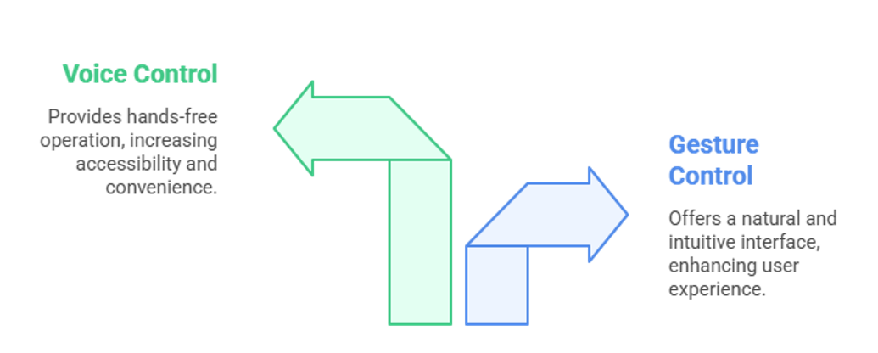
Problem Statement
Manual control of robots using remote or wired systems lacks intuitiveness and limits accessibility. There is a need for a more natural and intelligent way to control robotic movement using human-friendly interfaces like gestures and voice.
SVNIT Surat

Slide 4
Objectives
Develop a hybrid robot that can be controlled by both hand gestures and voice commands.
Prioritize gesture-based control while allowing voice fallback when gesture input is neutral.
Implement real-time hand tracking using MediaPipe and voice command interpretation using an LLM.
SVNIT Surat

Slide 5
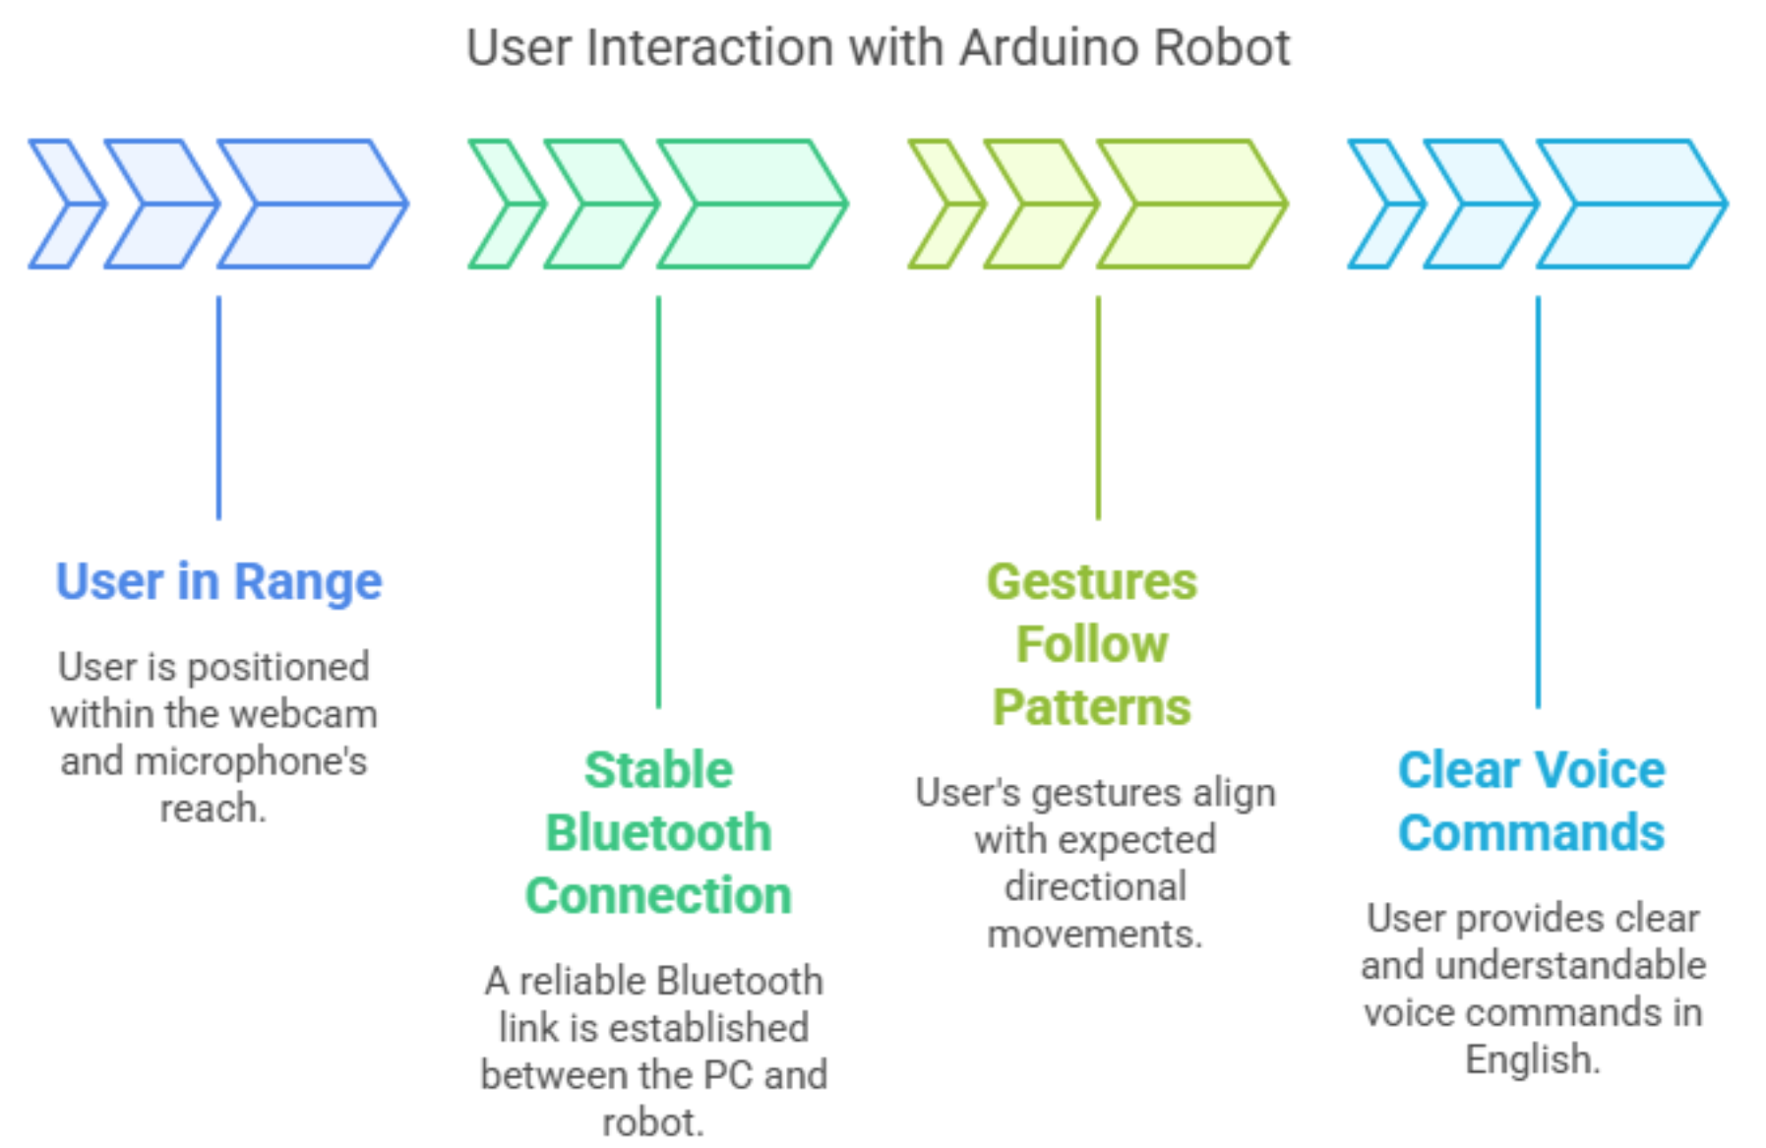
Assumption
The user is in range of the webcam and microphone.
A stable Bluetooth connection is established between the PC and the Arduino robot.
The gestures follow expected
directional patterns
(up, down, left, right).
Voice commands are given
clearly and in English.
SVNIT Surat

Slide 6
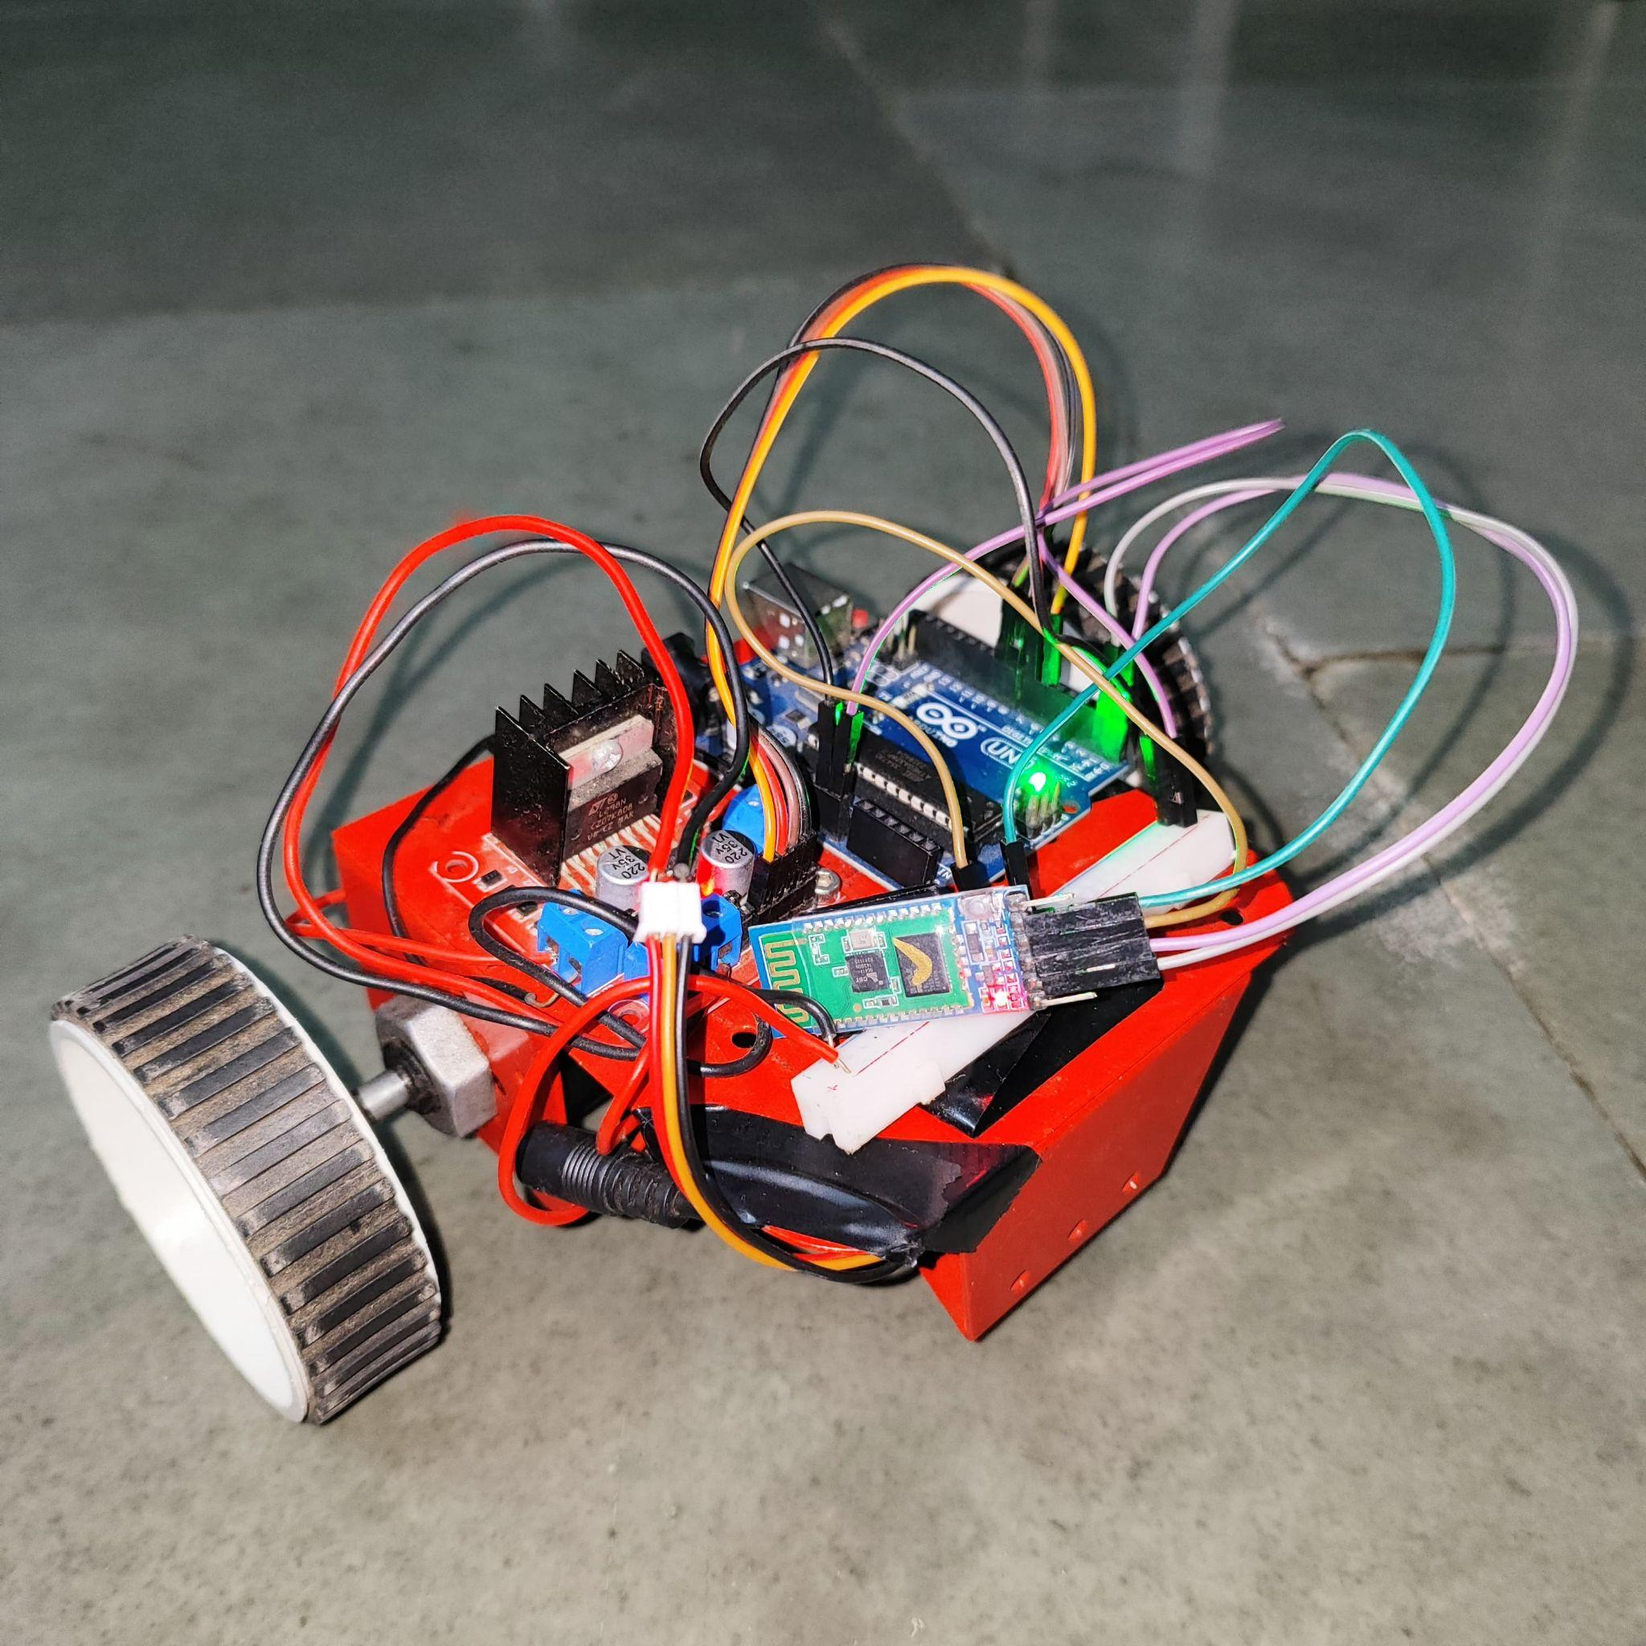
Agent Introduction
The robot system is designed as an intelligent agent that receives perceptual input through a webcam and microphone.
It acts based on gesture or voice interpretation to perform movement commands using motors via an Arduino controller, sends signals via bluetooth module (HC-05).
Gesture input is prioritized over voice
unless the gesture indicates 'neutral'.
SVNIT Surat

Slide 7
AI Module Used
MediaPipe (Google): For real-time hand gesture recognition.
OpenCV: For processing video frames and detecting gestures visually.
SpeechRecognition + PyAudio: For capturing and converting voice input to text.
GitHub-hosted OpenAI GPT 4.1 Model: For interpreting natural language voice commands into actionable robot movement instructions.
SVNIT Surat

Slide 8
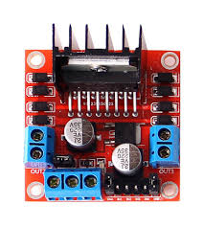

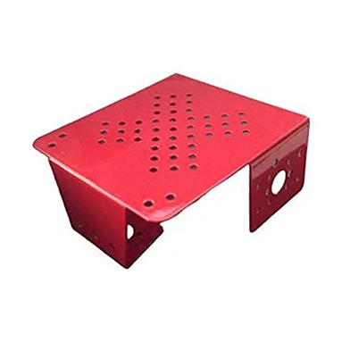


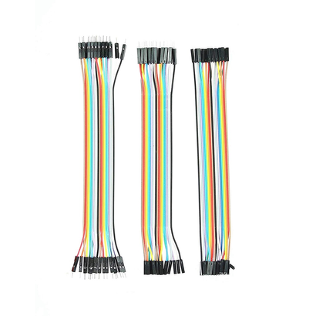
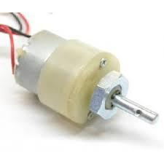
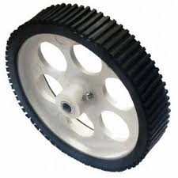


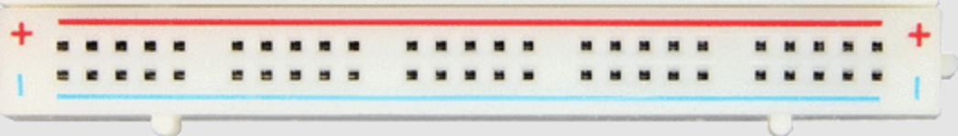
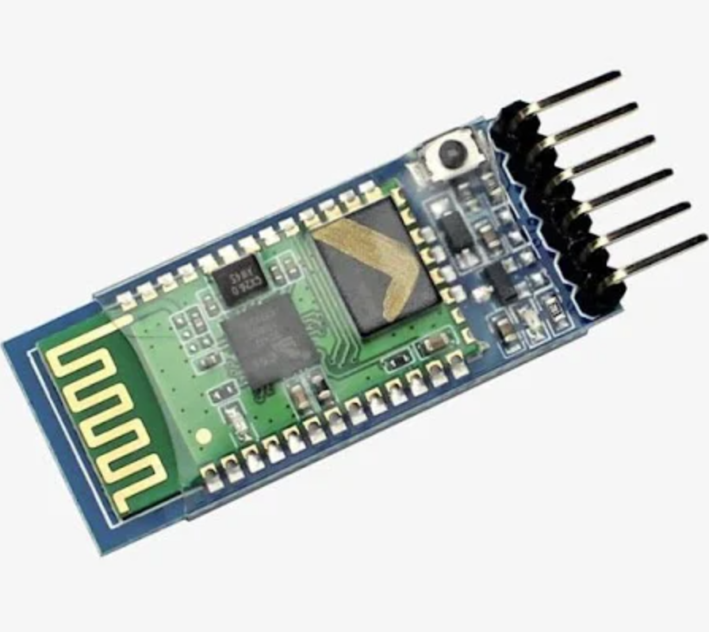

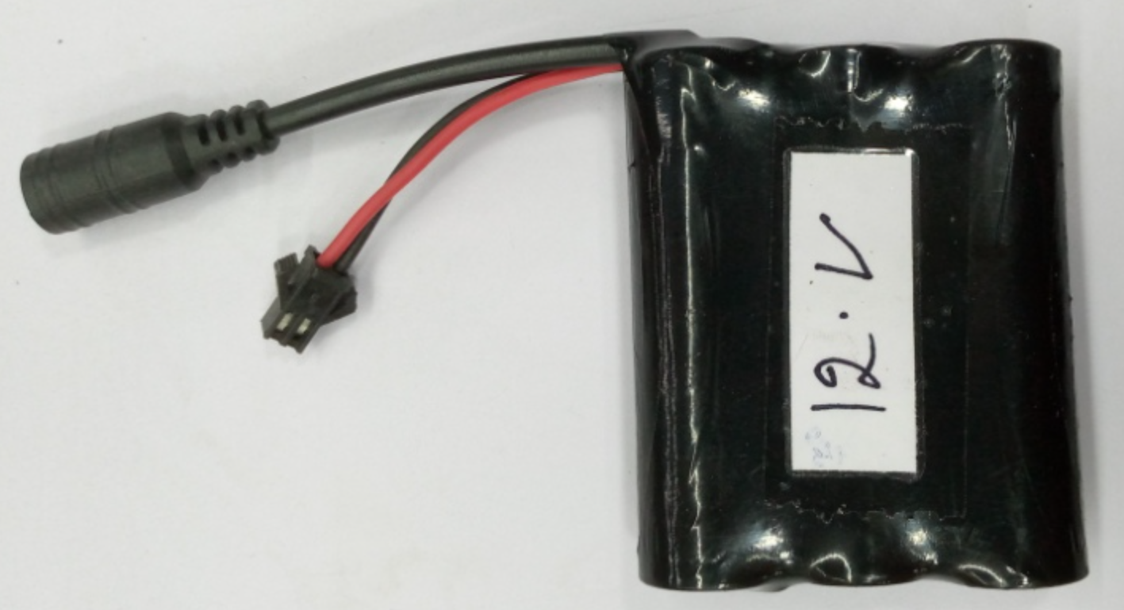
Hardware + Software
SVNIT Surat

Slide 9
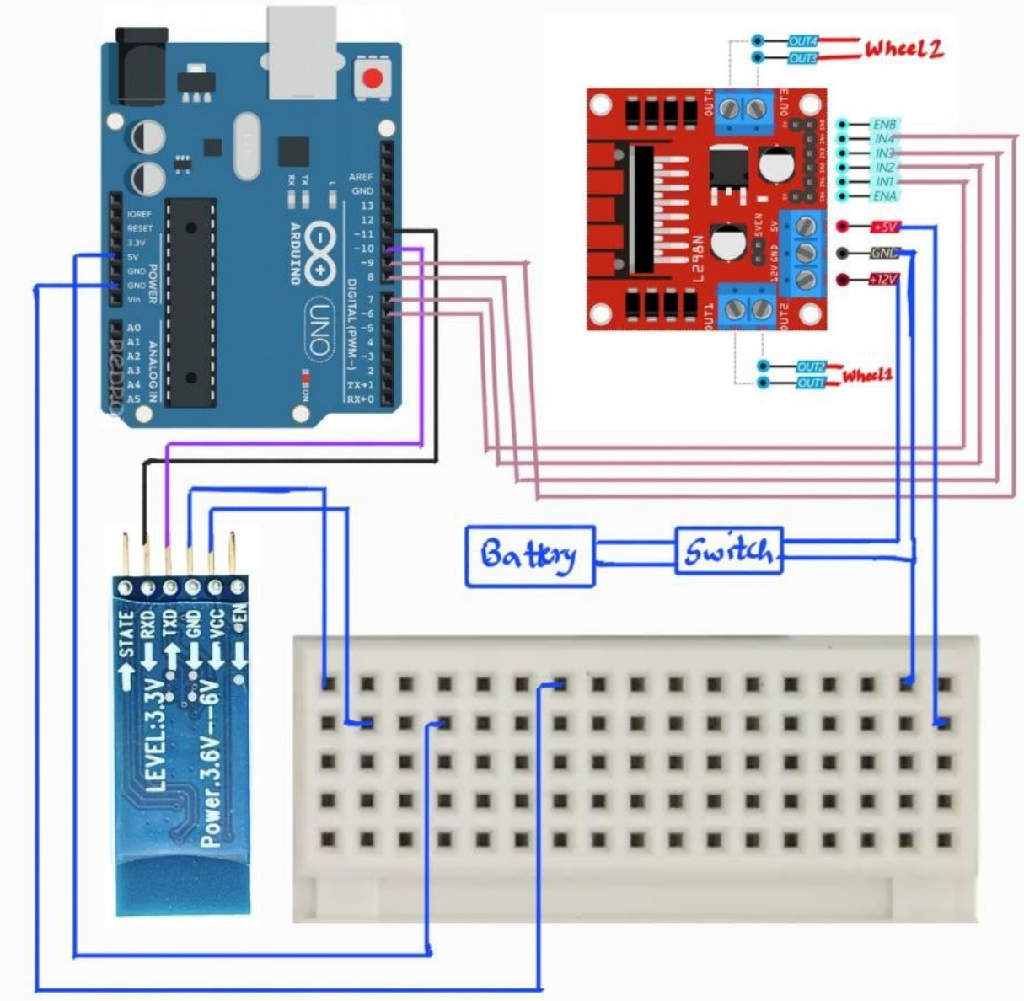
Circuit Diagram
SVNIT Surat

Slide 10

Working Video
SVNIT Surat

Slide 11
Our Learning
Learned integration of multiple AI tools (vision, NLP, voice) into a single real-time application.
Understood the significance of prioritizing control logic based on user behavior.
Gained hands-on experience with Arduino-Bluetooth interfacing and AI-driven control systems.
SVNIT Surat

Slide 12
References
MediaPipe Documentation by Google
OpenCV Python Tutorials
Speech Recognition Library
OpenAI / GitHub-hosted GPT 4.1 model endpoint
Arduino Motor Control Docs
SVNIT Surat

